Slide 1
How to add disk to VM

Slide 2
All configuration options and settings visible in this presentation can be different than yours. It depends on your privileges, settings and agreement.

Slide 3
Log in to VM Cloud Services

Slide 4
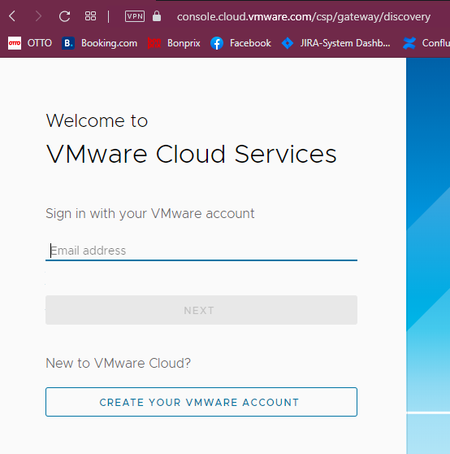
Enter the email address previously added to VMware Cloud Services

Slide 5
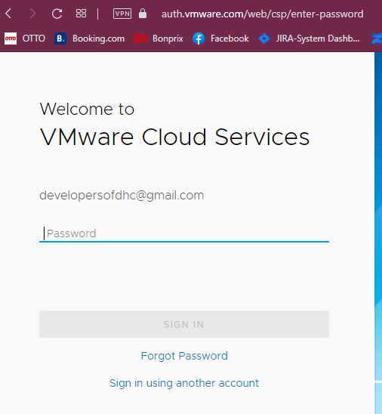
Enter the password for your account

Slide 6
Add disk to VM

Slide 7
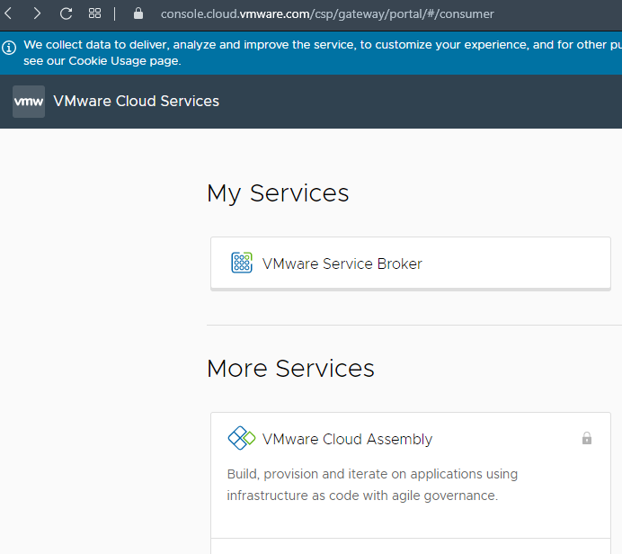
In Section “My Services” find a block with the title “Vmware Service Broker” – click on it.
Notice:
look of this page is up to your privileges and roles which are assigned to your account

Slide 8
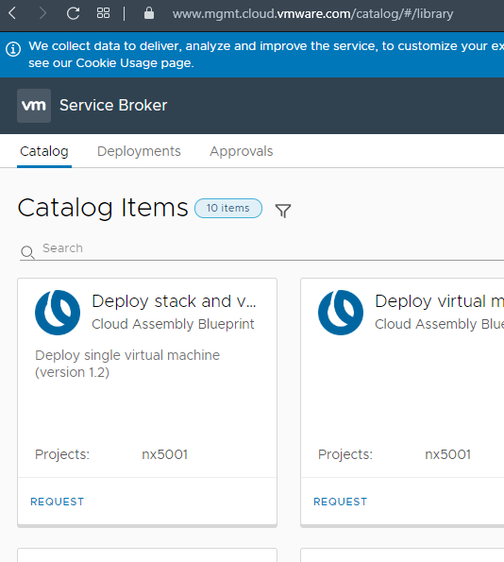
Please find the card “Deployments” on the top of a page. Click on it.
Notice:
You have to have already deployed Virtual Machine. Without VM you cannot add a disk to them.

Slide 9
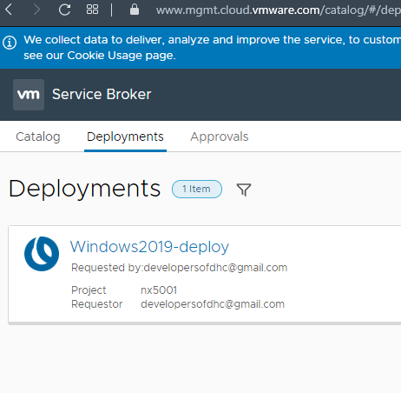
Find the machine you want to add the disk to. When you find an appropriate machine, click on the title of a finished process.
Notice:
On the page you can see many finished processes which deployed a single machine or series of machines. To identify the machine look on the title of a finished process.

Slide 10
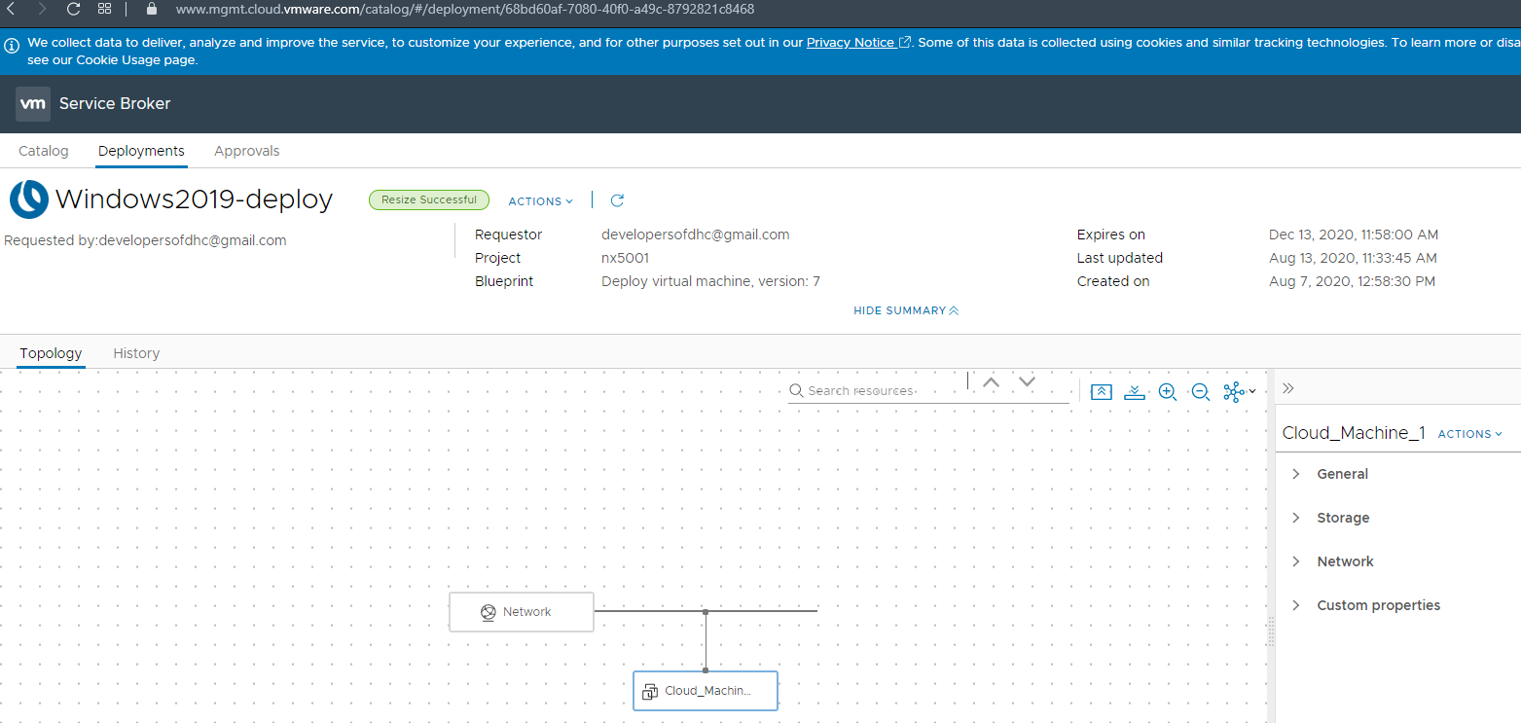
click “ACTIONS” on the right

Slide 11
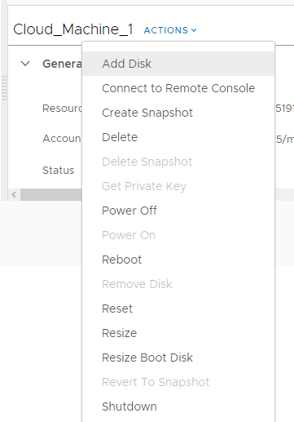
In the menu find the “Add Disk” and click on it. You will see new windows which allow you to define a new disk for VM.
Notice:
This option like others can be disabled. It depends on your privileges.

Slide 12
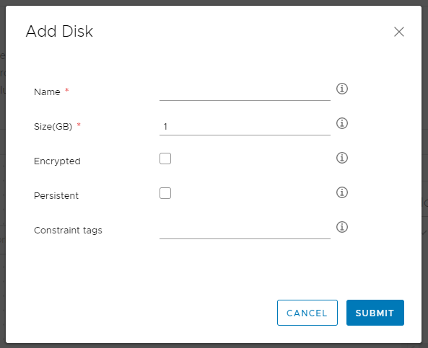
Name of a disk – it could be, for example, a letter „D”
Size of the new disk in GB
It is possible to create an encrypted disk
It is possible to create a persistent disk
It is possible to add tags to a disk
When you fill in this form click SUBMIT

Slide 13
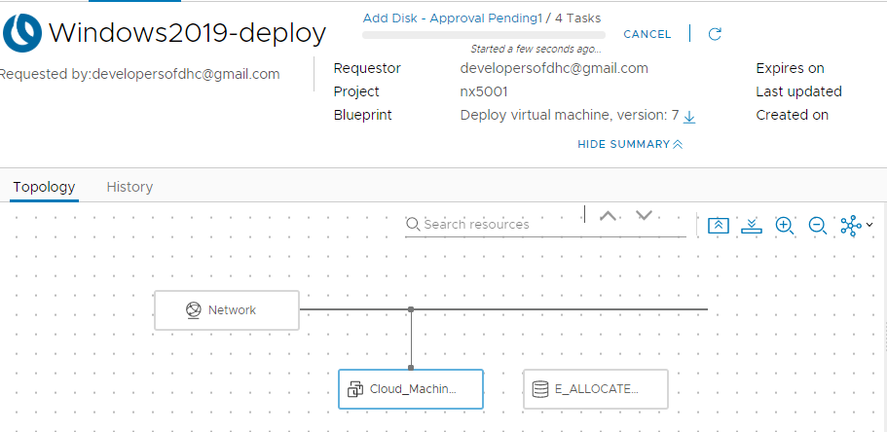
Status of a process adding a disk
New allocated disk (in progress)

Slide 14
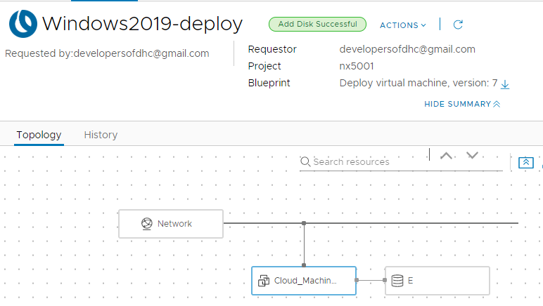
Status of a process
Notice:
When the process ends with an error, the label will be red with information about the error.
New disk visible in topology of VM

Slide 15
Thank you For more information please contact: T+ 33 1 98765432 M+ 33 6 44445678 firstname.lastname@atos.net

